Slide 1
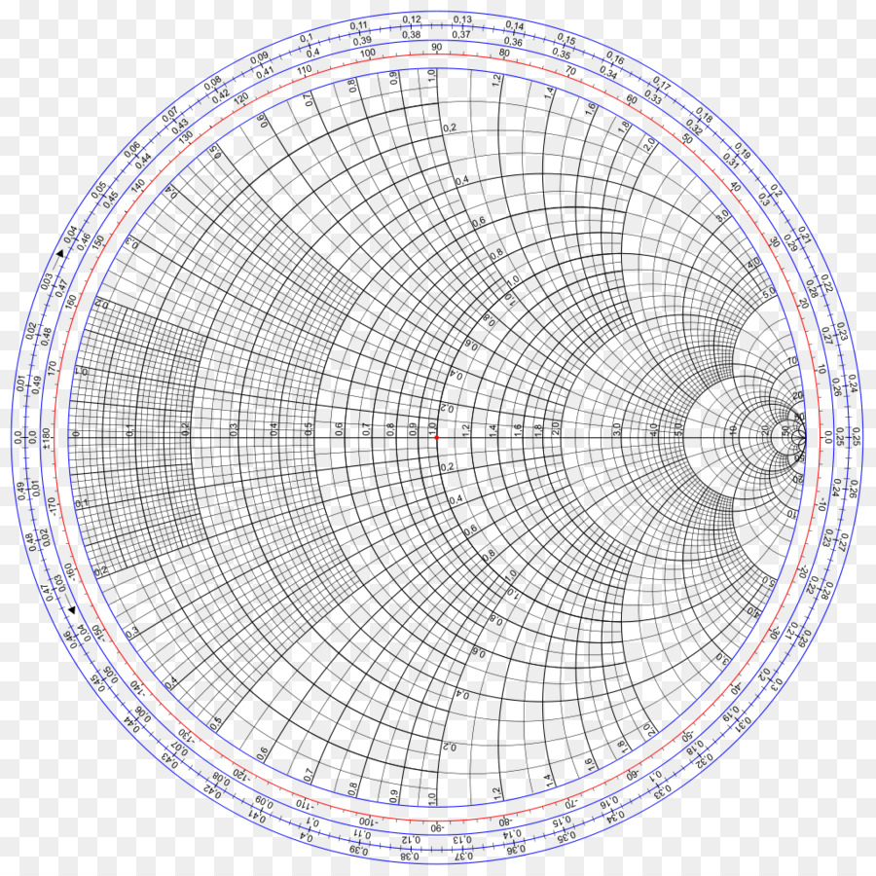
Q
P
1.2+0.8j
56 deg
G
ϴL
o
2
40 deg
S = 2.1

Slide 2
A
ZL
o
YL
B

Slide 3
(180-60)λ/720
= 0.1667 λ
O
zin= 0.68-j0.25
Zin = 47.6-j17.5Ω
1.15-j0.48
80.5-j33.6 Ω
P
Q
l= 432deg
300 deg

Slide 4
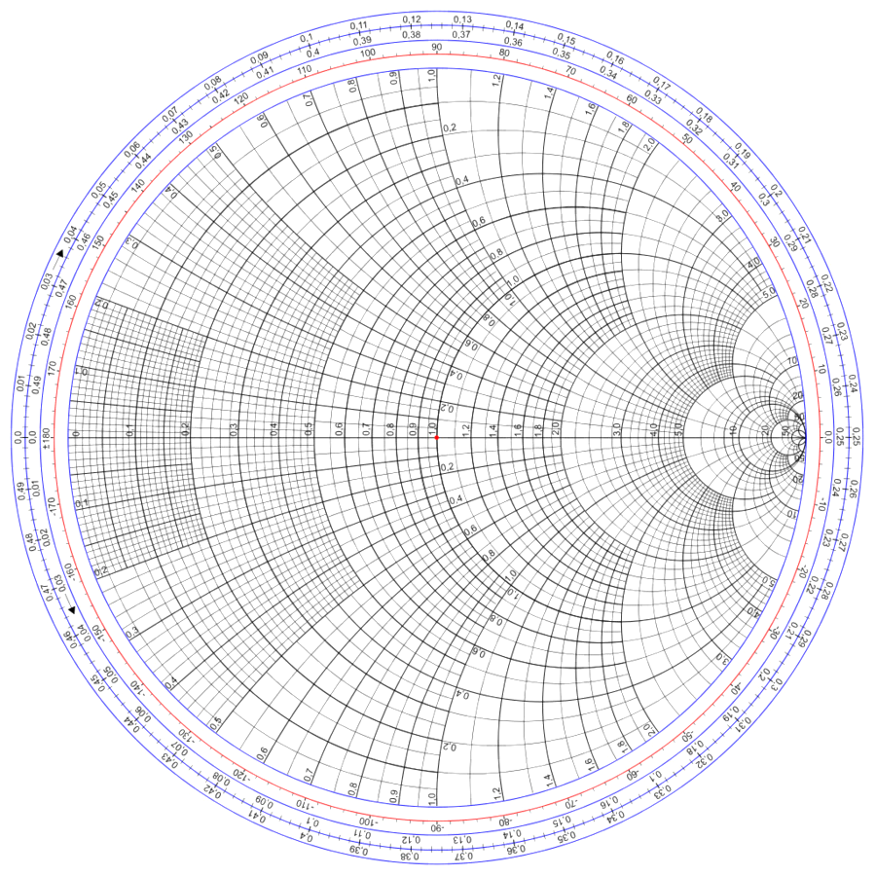
Zin = 0.3 – j0.63
R
Q
P
ZL = 1.33 + j2
Vmax
Vmin
288 deg
T
O
S = 4.8
72 deg
YL = 0.228 – j0.35
G
P’

